Slide 1



Mood Zen Assistant
EGT203 Engineering Design Project Pitching
Presented By:
Angel Zhang XinYu (221993P)
Mock Ying Jing (224416M)

Slide 2

Agenda
1 | Problem Statement
2 | Introduction: Mood Zen Assistant
3 | Components used
4 | What it solves
5 | Market Size and Scale
6 | Competition
7 | Extra info: Product demo
8 | Extra info: Design thinking process

Slide 3
Problem Statement
Our solution is to integrate meditation guidance, mood analysis, and focus enhancement into a single device, fostering improved mental well-being and productivity.

Slide 4
Introduction:
Mood Zen Assistant
BACKGROUND
CONCEPT
Studies have shown that mood lamp lighting can have a significant impact on the user's mood and state of attention.
Integrated a heart rate monitoring system
Provide user's heart rate statistics
Alert users to adjust their concentration/study mode when heart rate detected is too high
GOAL
Assist individuals struggling with focus and staying on task.

Slide 5
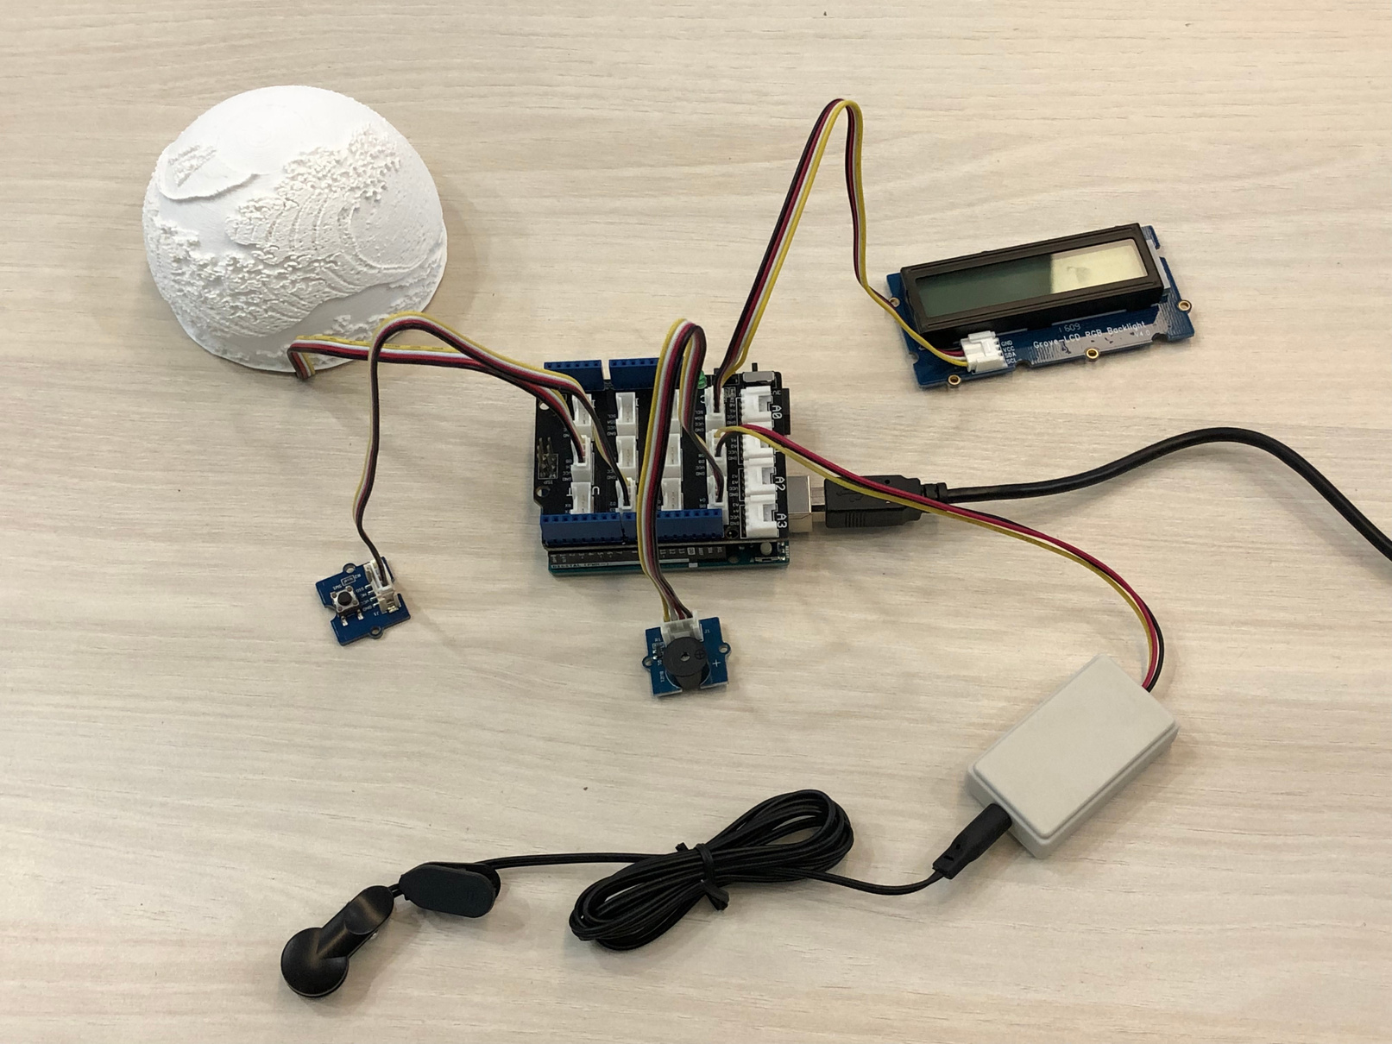
Components used:
Ear-clip Heart Rate Sensor (Grove)
LCD RGB Backlight
Buzzer (Grove)
LED Socket Kit (Grove)
Push Button (Grove)
Red Led (swappable)
Blue Led (swappable)
USB-C Cable
Mood Lamp (3D-printed)

Slide 6
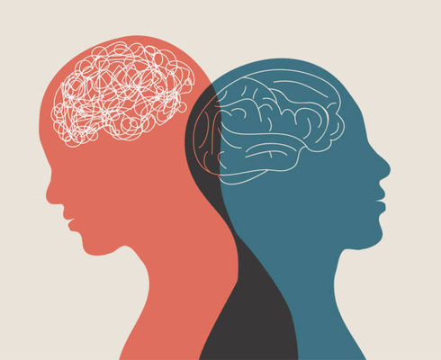
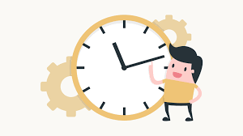
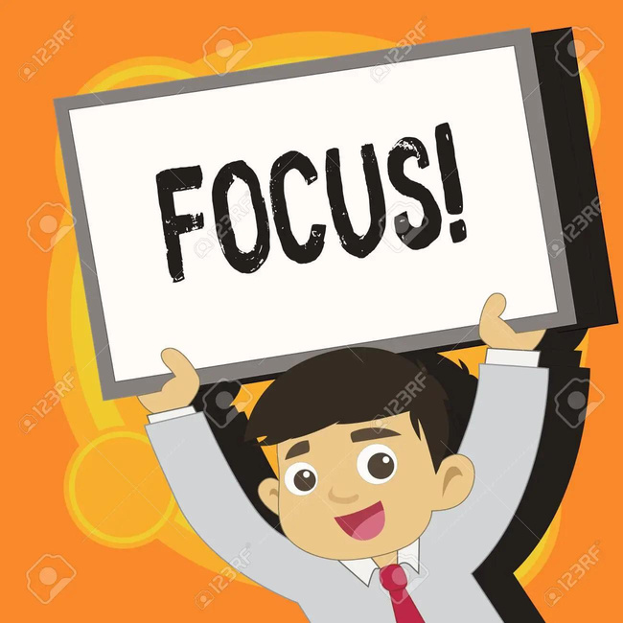
What it solves
How can Mood Lamp affect us?
Improve mental well-being
Enhance productivity
Improve focus and concentration
Offering visual cues through ambient LED lighting
Customise color to create the desired atmosphere
Providing users with meditation guidance and breathing exercises
Meditation guidance, Mood analysis, and focus enhancement features

Slide 7
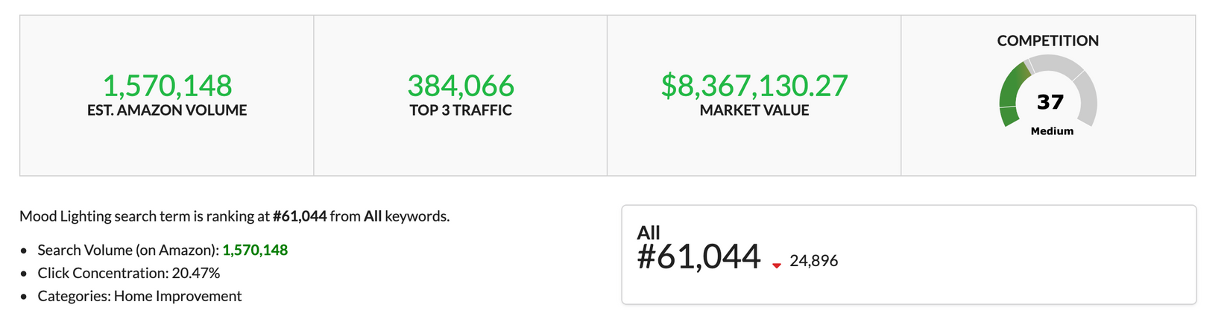
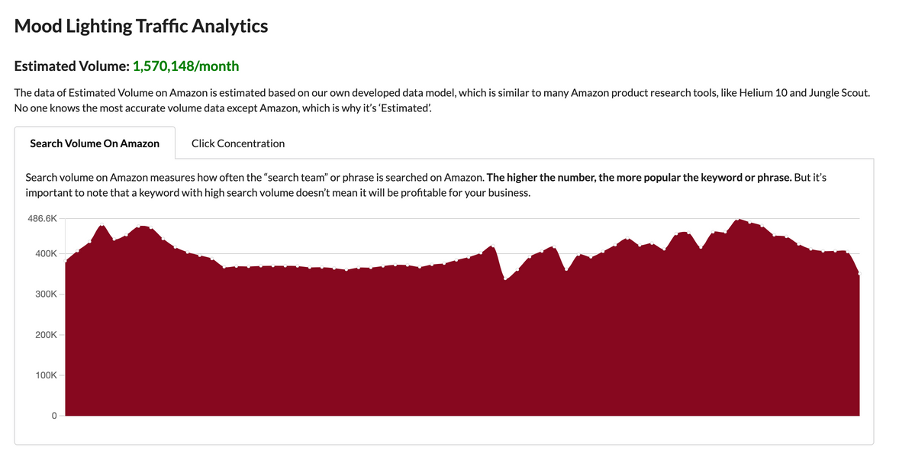
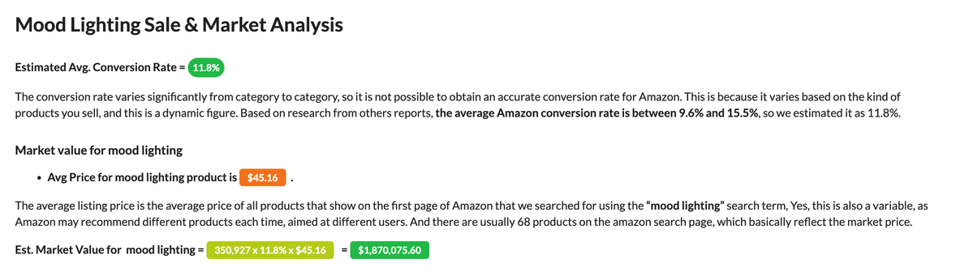
Market Size & Scale: Mood Lighting
Notes:
We have conducted market research, and the current search volume for mood lighting stands at 1.57 million units per month. The click concentration, indicating the interest level, is significant at 20.47%. With such demand, the market value has reached 8.36 million dollars.
The graph in red shows the traffic analytics monthly.

Slide 8
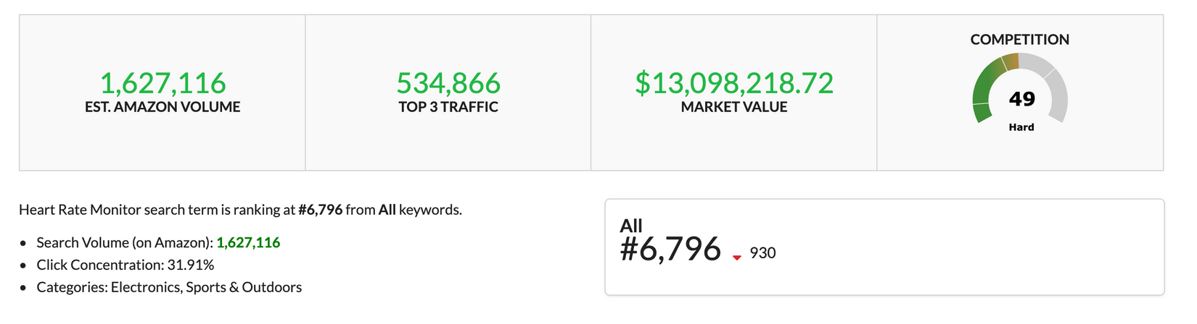

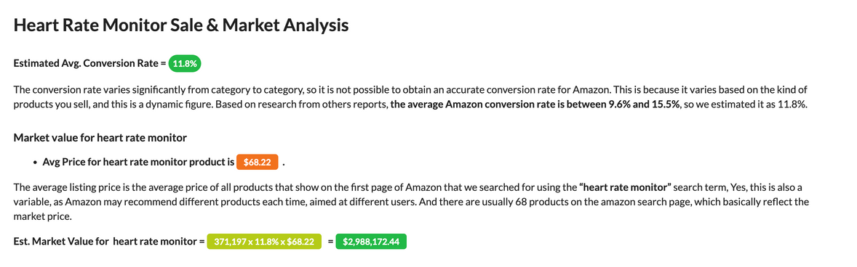
Market Size & Scale: Heart Rate Monitor
Notes:
Similarly, the current search volume for heart rate monitors stands at 1.62 million units per month. The click concentration is significant at 31.91%. With such demand, the market value has reached 13 million dollars.
The graph in red shows the traffic analytics monthly.

Slide 9
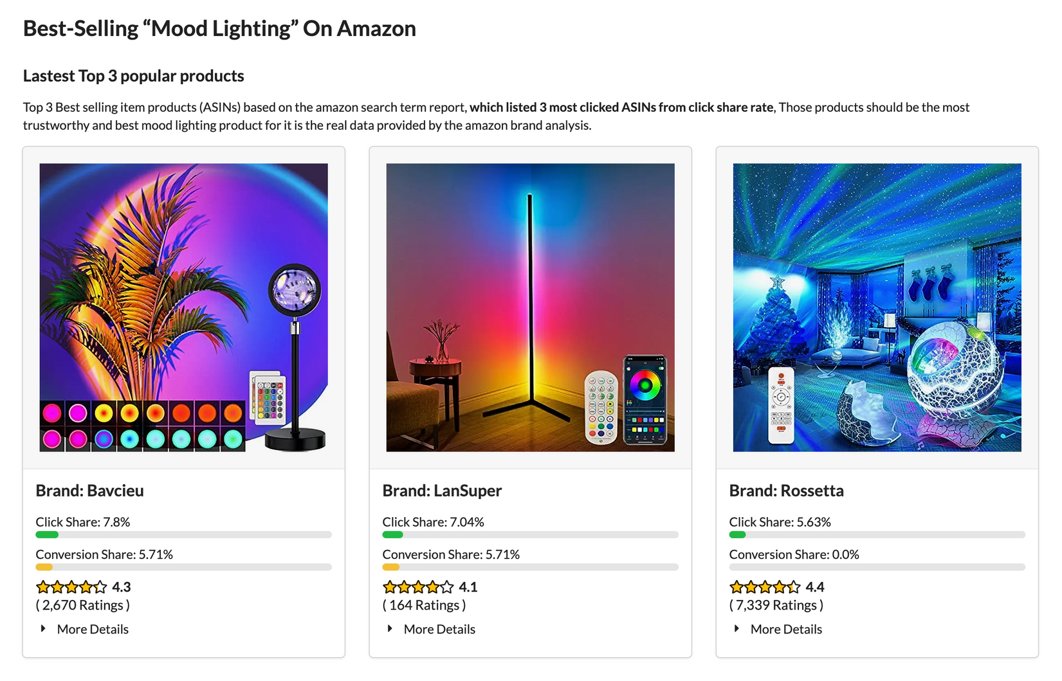
Competition: Mood Lighting
Notes:
Competition for mood lighting
These are the top 3 best selling mood lighting on amazon. The products has a
highest click share of 7.8%, followed by 7.04% and 5.63%.

Slide 10
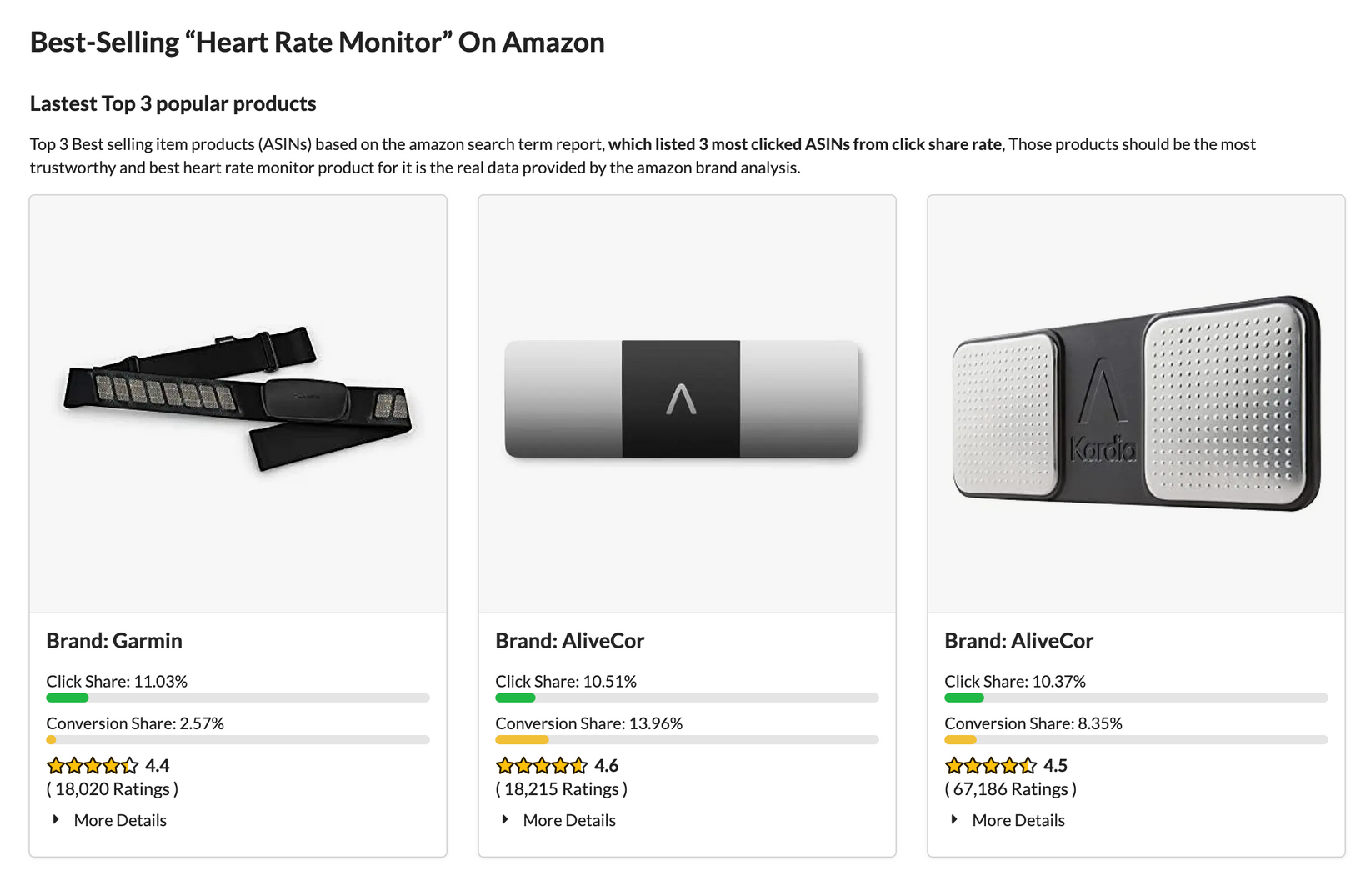
Competition: Heart Rate Monitor

Slide 11
Conclusion
Foster improved mental well-being
Enhancing users' productivity
Maintain optimal focus
Manage distractions effectively
Notes:
resulting in better academic and work performance.

Slide 12
Thank You!
"Unlock your mind's potential with our all-in-one oasis for well-being and focus - where meditation meets mood, and productivity soars."

Slide 13
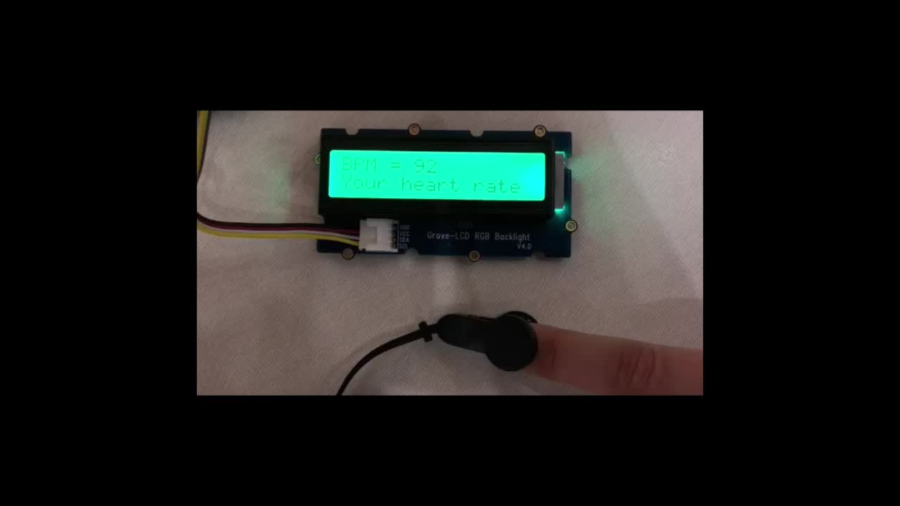
Product Demo: Heart rate < 100 BPM
For demonstration purposes:
Heart rate BELOW 100BPM will be deemed normal, anything ABOVE will need to be brought attention to
Notes:
1. Heart rate value will be displayed in row 1 of LCD
2. User's status will be displayed on the 2nd row of LCD (Your Heart rate is normal)
3. Press the button to off LED

Slide 14
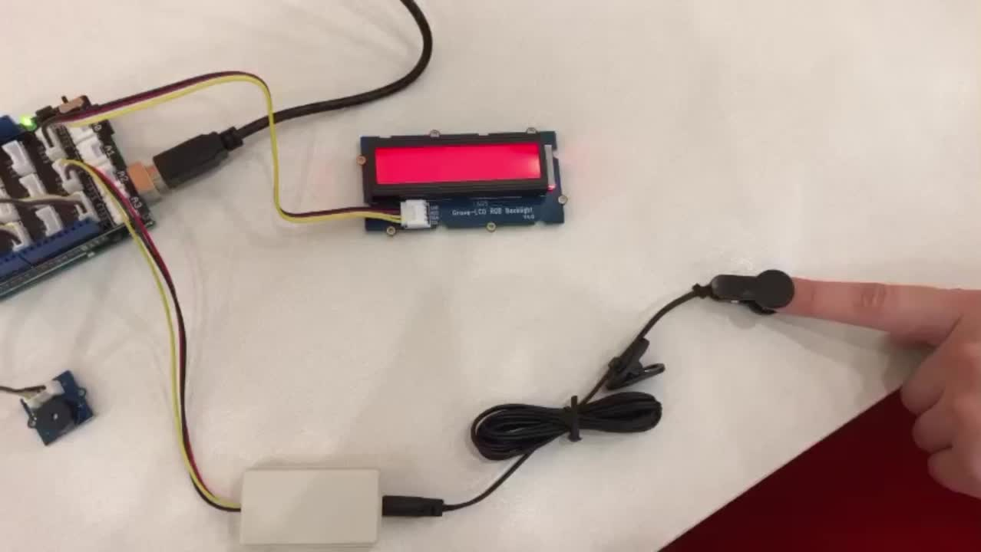
Product Demo: Heart rate > 100 BPM
Notes:
1. Buzzer alert user
2. Heart rate value will be displayed in row 1 of LCD
3. User's status will be displayed on the 2nd row of LCD (BPM is too high! Stand up and stretch a bit)
4. Press the button to off LED

Slide 15
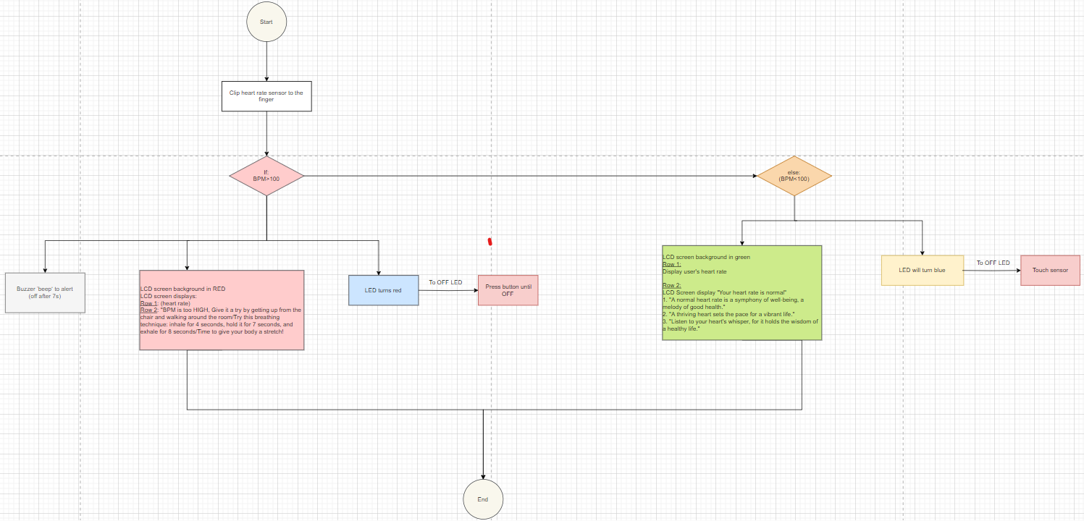
Coding Flowchart

Slide 16
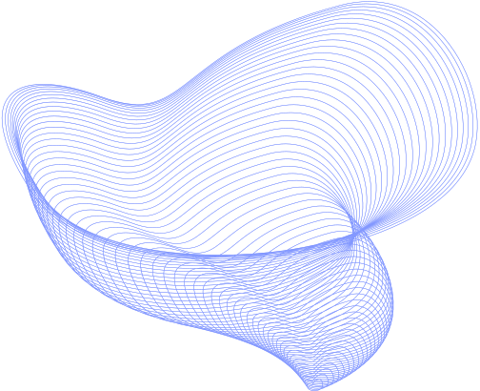
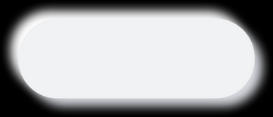


CUSTOMER
EMPATHY MAP
1
Who are we empathizing with?
GOAL
2
What do they need to do?
Students, Learners, Workers
keep calm and control their emotions.
Situation: Preparing for major exams, stress out about relationships problems
get their homework, revision, and work done.
plan their time wisely and take breaks.
6
What do they hear?
3
What do they see?
7
the price of product is very high
family/friends/friends told them that they are too stress
What do they think and feel?
A disruptive environment
being told need to relax
Pains
Gains
People's mood changes quickly due to
some circumstances
Improved mental
well-being
being told need to concentrate on work
lack of focus
distracted easily
Enhance productivity
mood management issue
4
What do they say?
Improve focus and
concentration
"I'm so done with it"
"Very stress sia"
"I don't want do already"
"So many tests and practicals need to study"
"I cannot focus!!"
5
What do they do?
procrastination
Slam their laptop indicating that they cannot continue any further
Throw paper or pen on the table
no motivation at all
gave up and stare into space
keeps fidgeting around

Slide 17



Problem
Statement
Our solution is to integrate meditation guidance, mood analysis, and focus enhancement into a single device, fostering improved mental well-being and productivity.
What is the problem?
How do we know this is a problem?
How will we know when we've
solved this problem?
Inefficient in work/study
We are students who can empathize
Lack of focus
Improved mental well-being state of user
Improved Concentration of user
Workloads are very heavy
Not productive
Easily influenced by mood
Youngsters our age can be eaily distracted
Be more focused
Productive in work
Youngsters need more emotional help to be stable
Teenagers lack self-control
Lack of concentration

Slide 18



MINDMAPPING
Analysis
Problem Statement
Aware that some students or workes may find it challenging to concentrate on their work or academics.
Providing a solution that integrates meditation guidance, mood analysis, and focus enhancement into a single device, fostering improved mental well-being and productivity.
MOOD
LAMP
Benefits
Strategy
Help to stay on tasks
Helps them to be more productive in their studies
Influence users' moods and emotions
By using Arduino and its various sensors, and creating the prototype of the lamp using 3D printing
Objectives
Solution
Enhance Productivity
Improve mental wellbeing
Improve Focus
Improve state of concentration
Provide guidance on controlling their emotions and mood
Integrates meditation guidance, mood analysis, and focus enhancement into a single device, fostering improved mental well-being and productivity.

